Slide 1
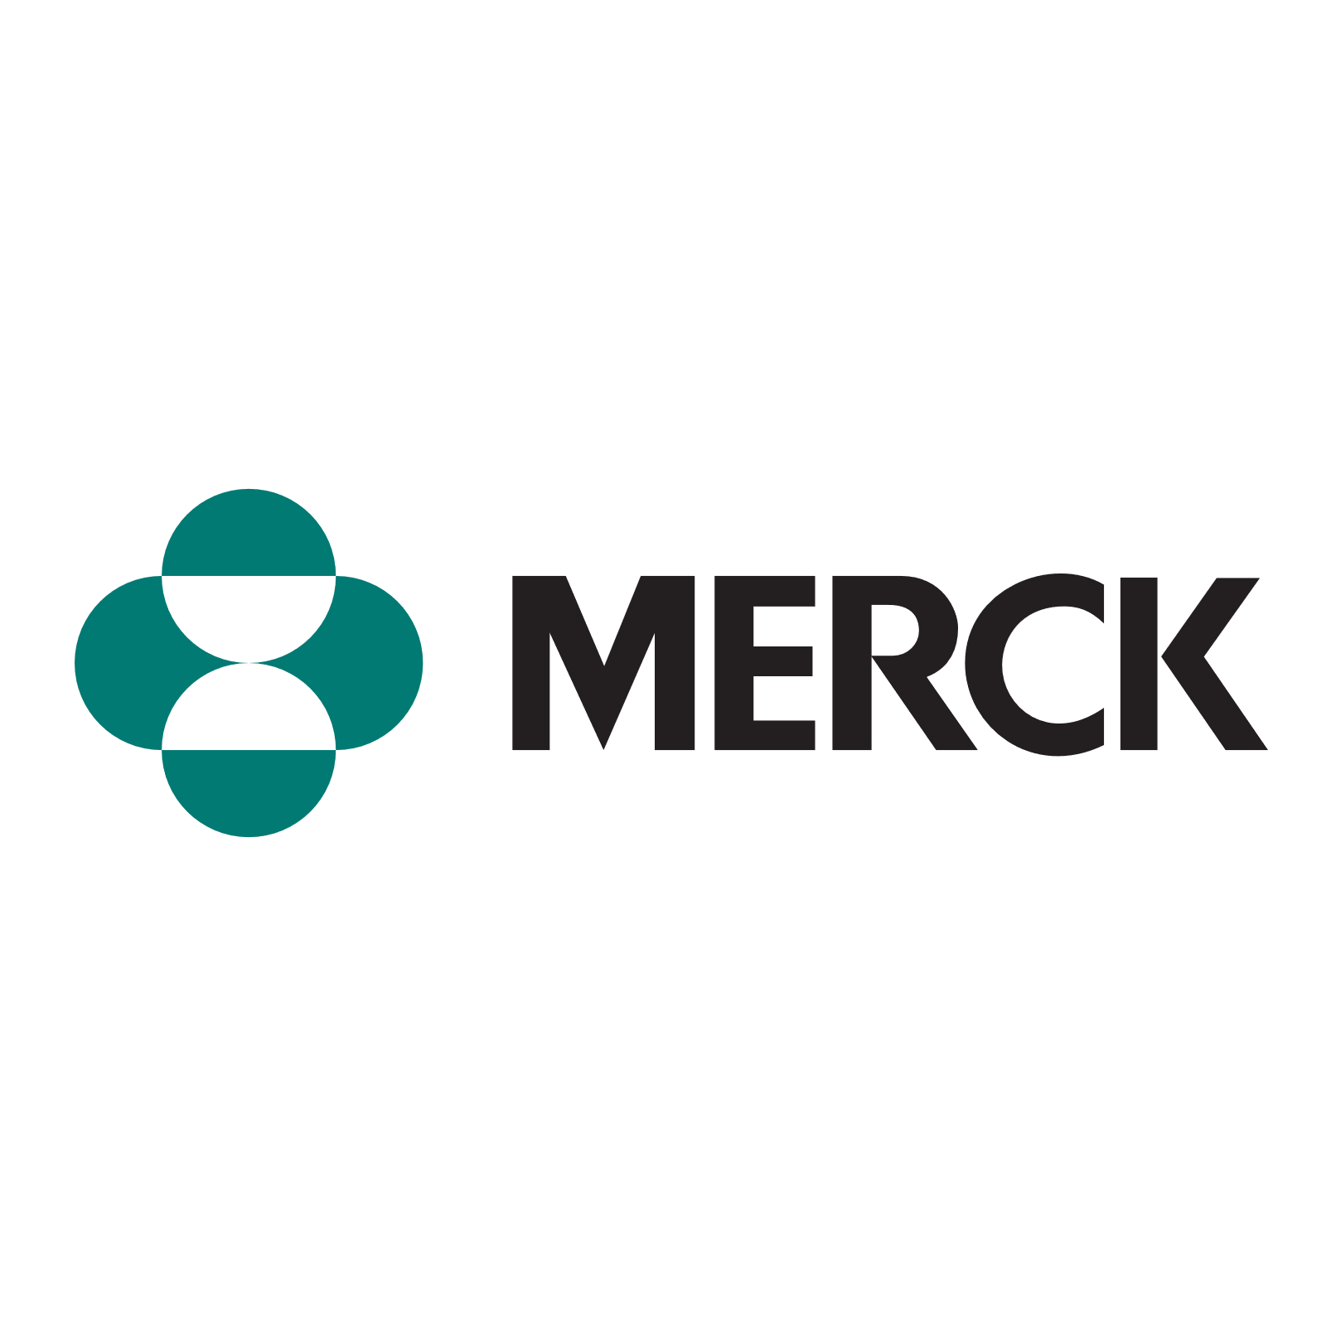
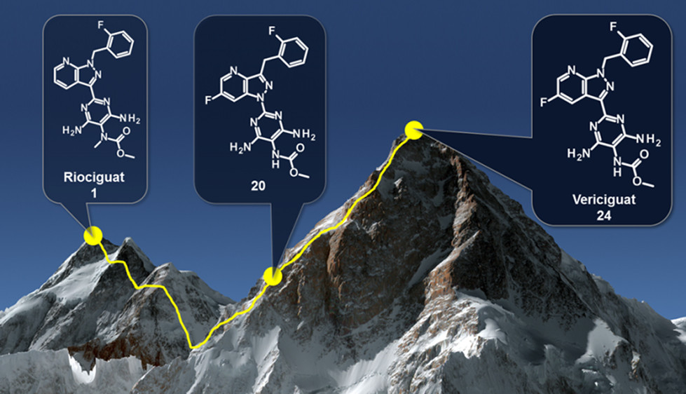
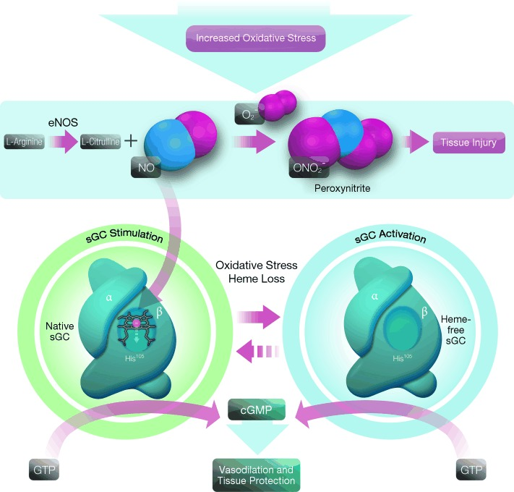
Vericiguat (Verquvo) Merck
Nitric oxide (NO) is a cardiovascular signaling molecule that interacts with soluble guanylate cyclase (sGC) and induces vasodilation
In patients with cardiovascular diseases, reactive oxygen species oxidize sGC and prevent stimulation by NO
Increasing NO concentration is insufficient to treat cardiovascular diseases because of this deactivation of sGC.
Two types of sGC targeting small molecules:
Stimulator – make active sGC more sensitive to NO and can independently activate native sGC
Activator – can induce conversion of GTP to cGMP in heme-free sGC, promoting vasodilation even with reduced NO bioavalability.
Riociguat | Vericiguat
Low metabolic stability | High metabolic stability
Modest bioavailability and activity | High activity
Limited application | Approved for wide range of diseases
2/6/2021
Peter Ryffel
1

Slide 2
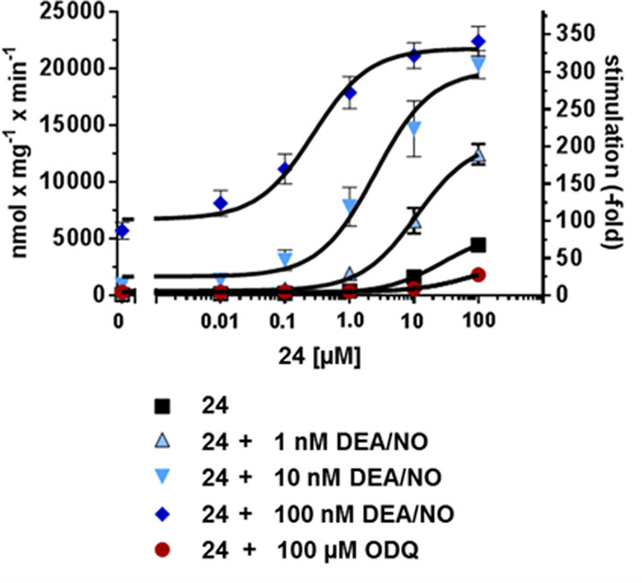
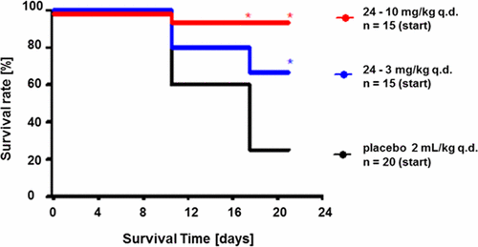
Vericiguat (Verquvo) Merck
Synthesis
Potency and Stability
No oxidative metabolism!
2/6/2021
Peter Ryffel
2

