Slide 1
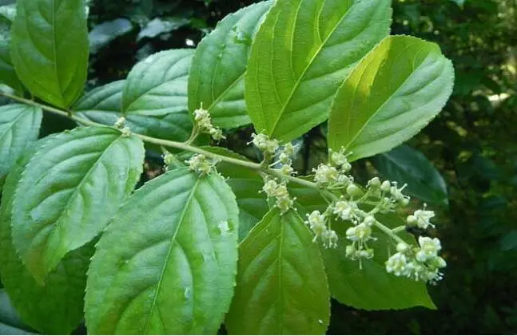
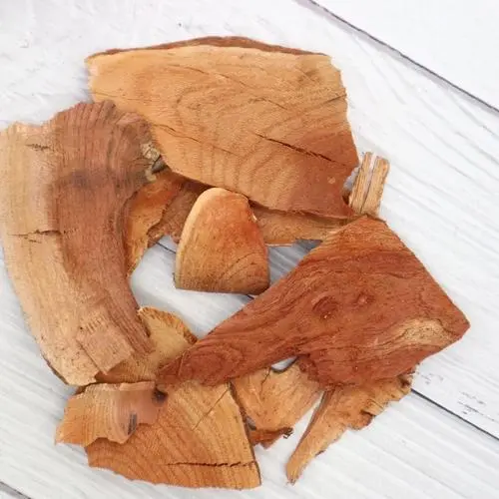
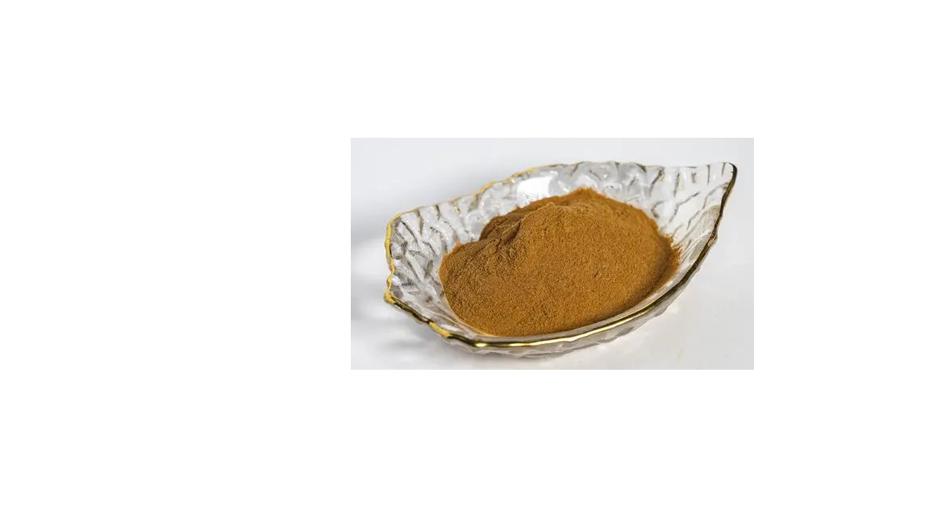
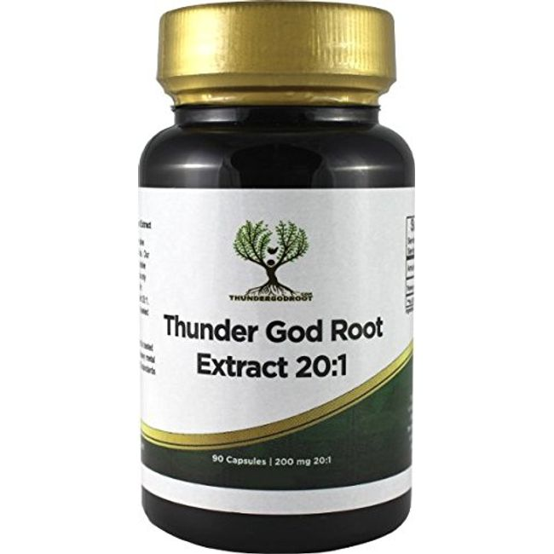
Natural Products from Tripterygium wilfordii
Outline
Introduction
Bioactivity & Synthesis
2.1 Diterpenes
2.2 Triterpenes
2.3 Alkaloids
Introduction
Tripterygium wilfordii is a Chinese herb
commonly called the “thunder god vine”
(Lei Gong Teng). It is mainly distributed in
southwest to southeast China.
The medicinal use of Tripterygium wilfordii
was first recorded in A Supplement to
Compendium of Materia Medica in 1765,
including treatment of edema, abdominal mass, malaria, inguinal bubo and arthralgia.
Tripterygium wilfordii root extracts have been a commercially available medicine and serve as a traditional therapy for treating rheumatoid arthritis (RA). The extracts also have anti-inflammatory and immunosuppressive effects.
Review
Xu, R. -S. Stud. Nat. Prod. Chem. 2005, 32, 773. https://doi.org/10.1016/S1572-5995(05)80068-7
Zhang, Y. Med Res Rev. 2021, 41, 1337. https://doi.org/10.1002/med.21762
Greer, A. J. Nat. Prod. 2004, 67, 1141. https://doi.org/10.1021/np049899e
Berube, G. Molecules 2021, 26, 2340. https://doi.org/10.3390/molecules26082340
11/11/2023
Cheng Yang
1
Notes:
name came from its toxicity

Slide 2
Natural Products from Tripterygium wilfordii
11/11/2023
Cheng Yang
2
Notes:
name came from its toxicity

Slide 3
Diterpenes --- Triptolide
Antii-inflammatory: Triptolide inhibited T-cell proliferation and production of proinflammatory cytokines (IL-1, IL-2, IL-6, and IL-8), which were involved in rheumatoid arthritis, tumor growth, and wound healing.
Anticancer: Trioptolide suppressed activation of protein NF-Kβ and made tumor cells more sensitive to TNF-α-induced apoptosis.
Treating neurodegenerative diseases: Triptolide scavenged free radicals (NO, reactive oxygen species) and inhibited release of inflammatory factors (TNF-α) from microglia.
Triptonide inhibited proliferation of lymph cells and suppressed mixed lymphocyte culture, which indicated immunosuppressive activity.
Raskin, I. Phytochemistry. 2007, 68, 732. https://doi.org/10.1016/j.phytochem.2006.11.029
Retrosynthesis
11/11/2023
Cheng Yang
3
Notes:
name came from its toxicity

Slide 4
Diterpenes --- Triptolide
Berchtold, G. A. J. Am. Chem. Soc. 1980, 102, 1200. https://doi.org/10.1021/ja00523a065
11/11/2023
Cheng Yang
4
Notes:
name came from its toxicity

Slide 5
Diterpenes --- Triptolide
Sherburn, M. S. Chem. Commun. 2000, 44, 1226. https://doi.org/10.1039/B718754H
Tamelen, E. E. J. Am. Chem. Soc. 1982, 104, 867. https://doi.org/10.1021/ja00367a046
11/11/2023
Cheng Yang
5
Notes:
name came from its toxicity

Slide 6
Diterpenes --- Triptolide
Xu, M. J. Org. Chem. 2000, 65, 2208. https://doi.org/10.1021/jo9919613
Luo, T. P. J. Am. Chem. Soc. 2022, 144, 2292. https://doi.org/10.1021/jacs.1c12525
11/11/2023
Cheng Yang
6
Notes:
name came from its toxicity

Slide 7
Diterpenes --- Quionoids
Anti-inflammatory: Triptoquinones A–F reduced release of IL-1a and IL-1b. Triptoquinone A also suppressed NO formation by inhibiting induction of the mRNA for inducible nitric oxide synthase (iNOS).
Antitumor: Triptoquinone B showed moderate activity as inhibitors of human tumor cell (A549, IC₅₀ = 11.5 mcg/mL; MCF-7, IC₅₀ = 6.5 mcg/mL replication.
Raskin, I. Phytochemistry. 2007, 68, 732. https://doi.org/10.1016/j.phytochem.2006.11.029
Shishido, K. Tetrahedron Letters. 1997, 38, 4124. https://doi.org/10.1016/S0040-4039(97)00841-1
11/11/2023
Cheng Yang
7
Notes:
name came from its toxicity

Slide 8
Diterpenes --- Quinoids & Kauranes
Significant anti-HIV replication activities in H9 lymphocyte cells.
EC₅₀(tripterifordin) = 3100 nM
EC₅₀(neotripterifordin) = 25 nM
For inhibitory mechanism: Lee, K.-H. Curr.
Top. Med. Chem. 2003, 3, 155.
Krische, M. J. J. Am. Chem. Soc. 2016, 138, 12364. https://doi.org/10.1021/jacs.6b08902
11/11/2023
Cheng Yang
8
Notes:
name came from its toxicity

Slide 9
Diterpenes --- Kauranes
Corey, E. J. J. Am. Chem. Soc. 1997, 119, 9929. https://doi.org/10.1021/ja972549c
Kobayashi, S. J. Org. Chem. 2018, 83, 1606. https://doi.org/10.1021/acs.joc.7b02916
11/11/2023
Cheng Yang
9
Notes:
name came from its toxicity

Slide 10
Triterpenes --- Celastrol
Antii-inflammatory: Celastrol reduced levels of cytokines (IL-1, IL-2, IL-6, IL-8 and TNF-α) by inhibiting transfer of NF-Kβ to the nuclei and decreasing levels of phosphorylated p38.
Anticancer: Celastrol was toxic to several human cancer cell lines and induced apoptosis, which partly due to the inhibition of topoisomerase II. Celastrol also affected expression of several cancer-related genes (e.g. inhibiting transcription of c-myc)
Treating neurodegenerative diseases: Celastrol activated the action of heat shock transcription factor (HSF1) and inhibited TNF-α and iNOS, which made it a potential therapeutic agent for the treatment of Amyotrophic lateral sclerosis (ALS).
Raskin, I. Phytochemistry. 2007, 68, 732. https://doi.org/10.1016/j.phytochem.2006.11.029
Kampranis, S. C. Nat.. Chem. 2023, 15, 1236. https://doi.org/10.1038/s41557-023-01245-7
11/11/2023
Cheng Yang
10
Notes:
name came from its toxicity

Slide 11
Triterpenes --- Celastrol
Siegel, D. J. Am. Chem. Soc. 2015, 137, 11864. https://doi.org/10.1021/jacs.5b06261
11/11/2023
Cheng Yang
11
Notes:
name came from its toxicity

Slide 12
Alkaloids --- Triptolide
Euonine showed good anti-feeding activity against the lepidopteran Spodoptera littoralis, with activity levels higher than that of the commercially available limonoid toosendanin. (EC₅₀ = 0.00018 mcg/cm²)
Immunosuppression: Evonimine exhibits significant inhibition of humoral-mediated immunity using the haemolytic response as an indicator. (Zhongguo Yaoxue Zazhi 1990, 25, 266.)
Raskin, I. Phytochemistry. 2007, 68, 732. https://doi.org/10.1016/j.phytochem.2006.11.029
Inoue, M. J. Am. Chem. Soc. 2021, 143, 21037. https://doi.org/10.1021/jacs.1c11038
11/11/2023
Cheng Yang
12
Notes:
name came from its toxicity

Slide 13
Alkaloids --- Triptolide
Inoue, M. J. Am. Chem. Soc. 2021, 143, 21037. https://doi.org/10.1021/jacs.1c11038
11/11/2023
Cheng Yang
13
Notes:
name came from its toxicity

