Slide 1
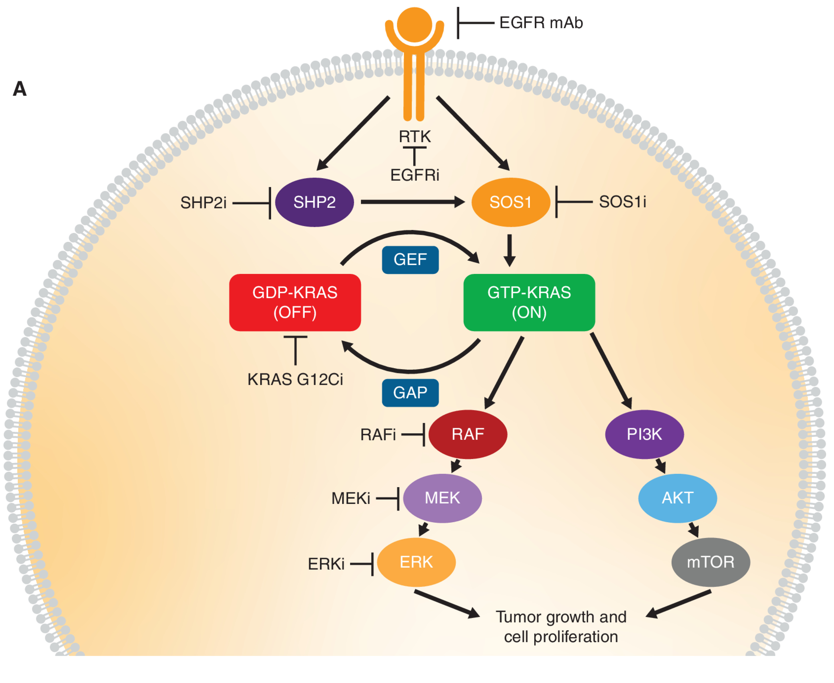
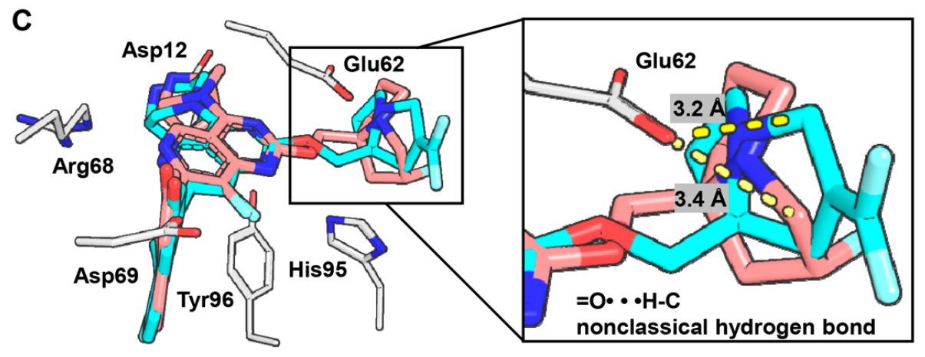
KRAS^{G12D} Inhibitors
Introduction
RAS protein is a member of the small-protein GTPase family and acts as an important regulator of many cellular events. Of the three RAS isoforms (NRAS, HRAS, and KRAS), KRAS is the most commonly altered in human tumors.
KRAS^{G12D} has been reported as the most frequently altered RAS oncogene, accounting for approximately 40% of PDAC (pancreatic ductal adenocarcinomas) and 10−12% of CRC (colorectal cancer cases).
Haigis, K. M. Cancer Discovery. 2022, 12, 913. https://doi.org/10.1158/2159-8290.CD-22-0035
Molecular Docking
The piperizine moieties bind with Arg12 of GTP-KRAS through hygrogen bond.
The F-substituted pyrrolizidine motif in MTRX1133 bind with Glu62 via an ionic interaction along with a non-classical O···H−C hydrogen.
The gem-difluoroalkene in compound I and II introduce ring strain and make the allylic methylene closer to Glu62, reinforceing the binding of gem-diﬂuoroalkene with the carboxylate anion of Glu62 via anion−π interactions.
KRAS proteins have high picomolar affinity with GTP/GDP and act as molecular switch, cycling from a GTP-bound “on” state to a GDP-bound “oﬀ” state.
In tumor cells, part of point mutations cause the protein to be locked in the GTP-bound state and abnormal activation of downstream signaling pathways.
Zhang, A. J. Med. Chem. 2023, 66, 15524. https://doi.org/10.1021/acs.jmedchem.3c01724
12/2/2023
Cheng Yang
1

Slide 2
KRAS^{G12D} Inhibitors
Synthesis
Zhang, A. J. Med. Chem. 2023, 66, 15524. https://doi.org/10.1021/acs.jmedchem.3c01724
12/2/2023
Cheng Yang
2

