Slide 1
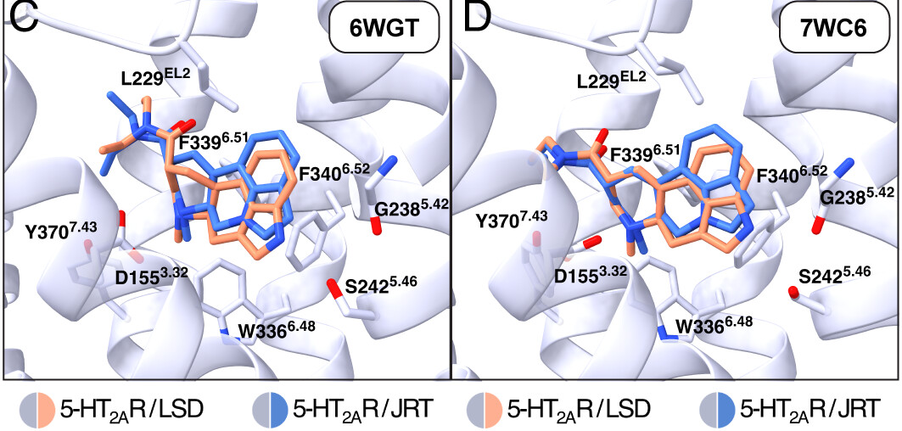
(+)-JRT
Biological properties
Highly selective for Serotonin receptors
Promotes Neuroplasticity
Does not exacerbate the positive symptoms of SCZ
Does not promote SCZ-related gene expression
Produces robust Antidepressant-Like effects
Promotes Cognitive Flexibility
Design of JRT
(+)-JRT is predicted to adopt similar binding poses as LSD
Indole nitrogen is predicted to be removed from S242^{5.46} or G238^{5.42}
Olson, D. E. Proc. Natl. Acad. Sci. 2025, 122 (16). https://doi.org/10.1073/pnas.2416106122.
Olson, D. E. Journal of Medicinal Chemistry 2020 63 (3), 1142-1155. 10.1021/acs.jmedchem.9b01404
7/18/2025
Artem Lykov
1

Slide 2
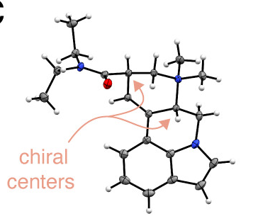
(+)-JRT
Retrosynthesis
Synthesis
Olson, D. E. Proc. Natl. Acad. Sci. 2025, 122 (16). https://doi.org/10.1073/pnas.2416106122.
7/18/2025
Artem Lykov
2

Slide 3
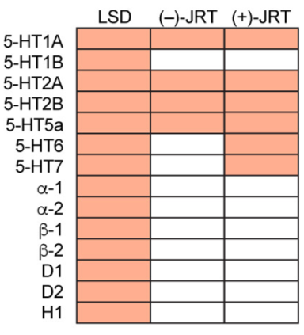
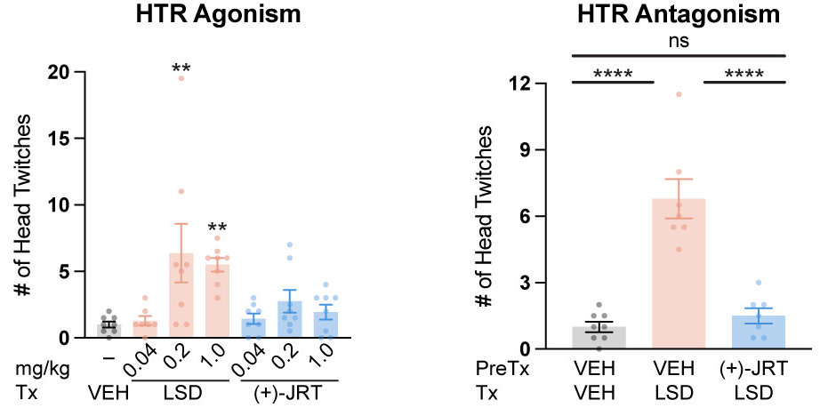
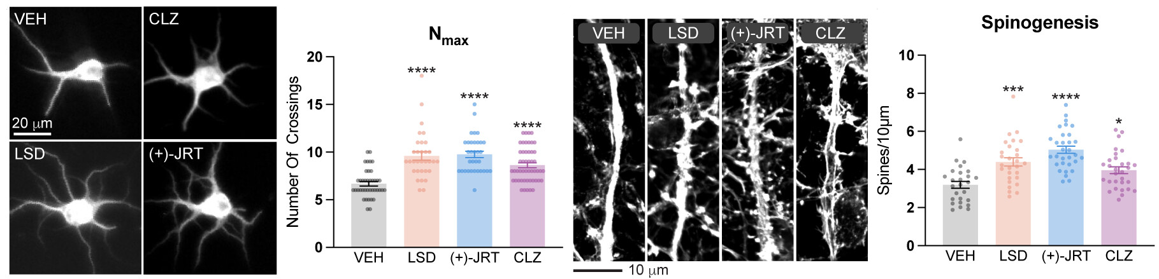
(+)-JRT
Biological tests
Radioligand binding (RLB) profiles showed that (+)-JRT is highly selective for serotonin receptors
Head-twitch response (HTR) showed that
(+)-JRT does not exacerbate hallucinogen-like activity in vivo (maybe)
(+)-JRT promotes structural plasticity in vitro and in vivo
Olson, D. E. Proc. Natl. Acad. Sci. 2025, 122 (16). https://doi.org/10.1073/pnas.2416106122.
7/18/2025
Artem Lykov
3

