Slide 1
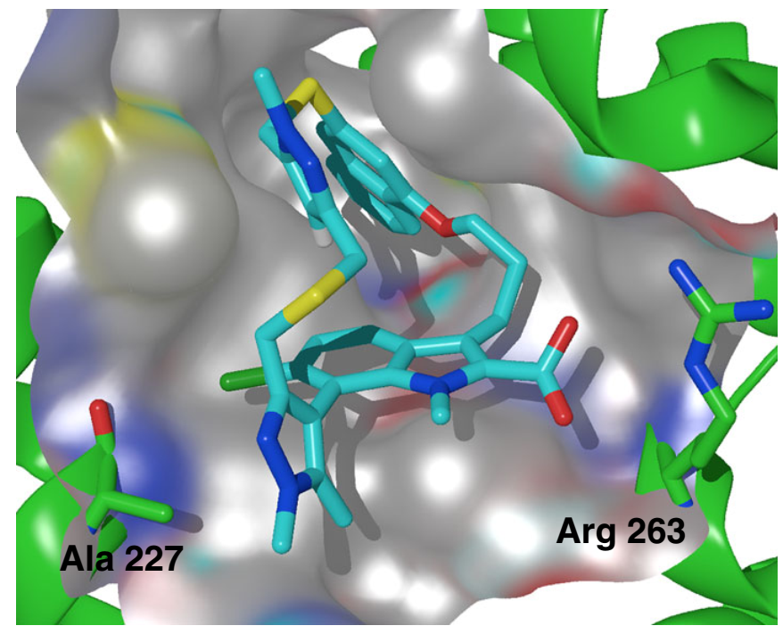
AZD5991
Introduction
Myeloid cell leukemia-1 (Mcl1) is a member of the Bcl2 family of proteins that promotes cell survival by preventing induction of apoptosis in many cancers.
The macrocyclic molecule AZD5991 shows high selectivity and affinity for Mcl-1. Studies demonstrated that only the (R_{a})-enantiomer was observed to bind to Mcl-1.
AZD5991 induces rapid apoptosis in cancer cells by activating the Bak-dependent mitochondrial apoptotic pathway. It shows potent antitumor activity in vivo with complete tumor regression in several models of multiple myeloma and acute myeloid leukemia.
Discovery Route
Nat. Commun. 2019, 9, 5341.
05/09/2025
Cheng Yang
1

Slide 2
AZD5991
10-grams-scale Synthesis
Org. Process Res. Dev. 2025, 29, 804.
05/09/2025
Cheng Yang
2
Notes:
simulated moving bed (SMB) separation

